Slide 1
11KW Project CLLLC Control Algorithm
Date: 22-July, 2022

Slide 2
Overview
Charger flowchart
Full-bridge configuration
Regulation scheme
Regulation state machine
Soft-start
Code Timing
Burst Mode
Regulation mode select
Synchronous rectifier control

Slide 3
Charger flowchart
Start
Legend
G2V – grid-to-vehicle
V2G – vehicle-to-grid
FB – full-bridge
MD – main drive
SR – synchronous rectifier
PFM – pulse frequency modulation
PSPWM – phase shift PWM
Forward /
Reverse
configure
pri=MD,
sec=SR
Forward
Reverse
configure
pri=SR,
sec=MD
PFM, PSPWM, burst
PFM, PSPWM, burst

Slide 4
Regulation scheme
Control for full-bridge CLLLC configuration
Control | fs(kHz) | PS(°) | Burst duty(%)
Burst | 200 | 100 deg | 0≤x≤100
PSWM | 200 | 0≤x≤100 deg | 100
PFM | 45KHz≤x≤200KHz (53to96khz for Reverse) | 0 | 100
Lighter load

Slide 5
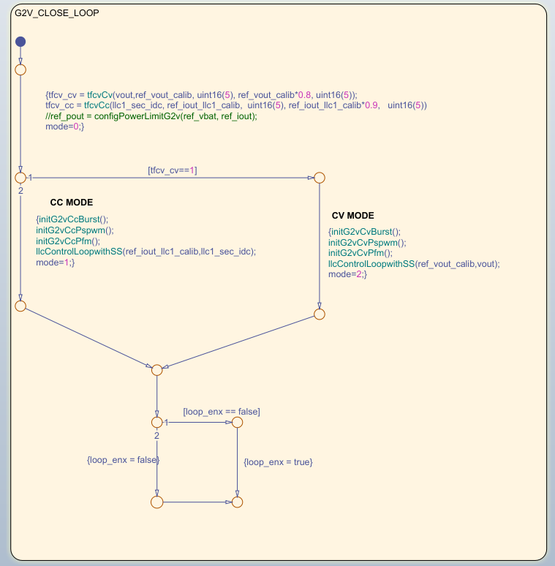
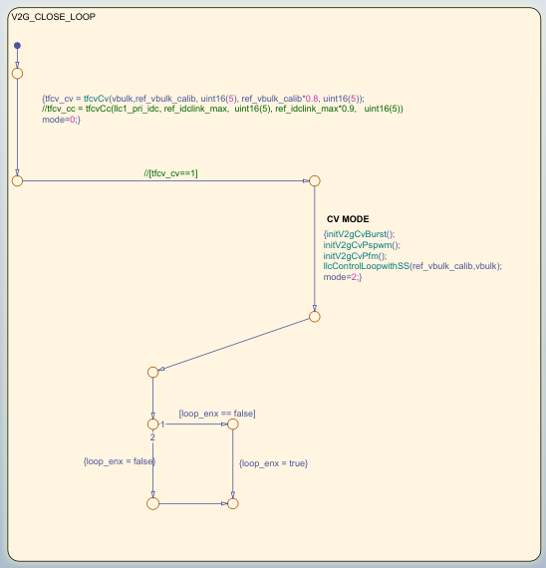
Regulation mode select
Forward Mode
Reverse Mode

Slide 6
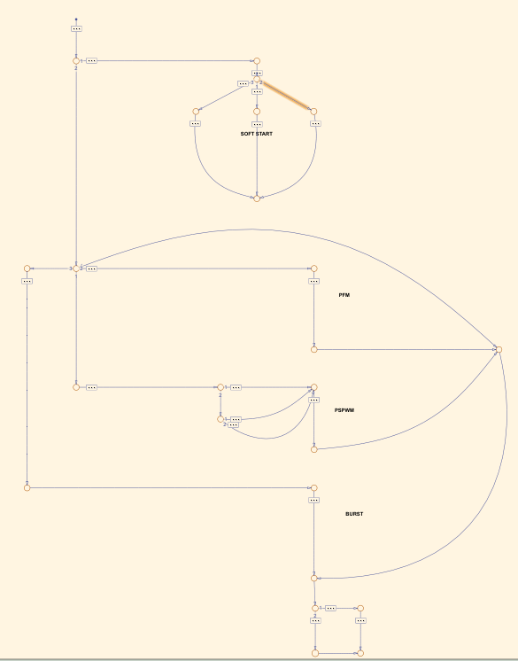
Close Loop Control

Slide 7
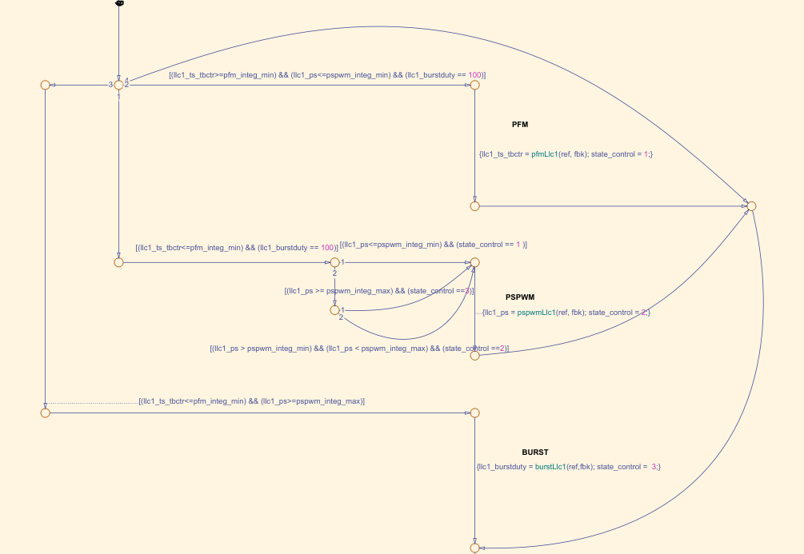
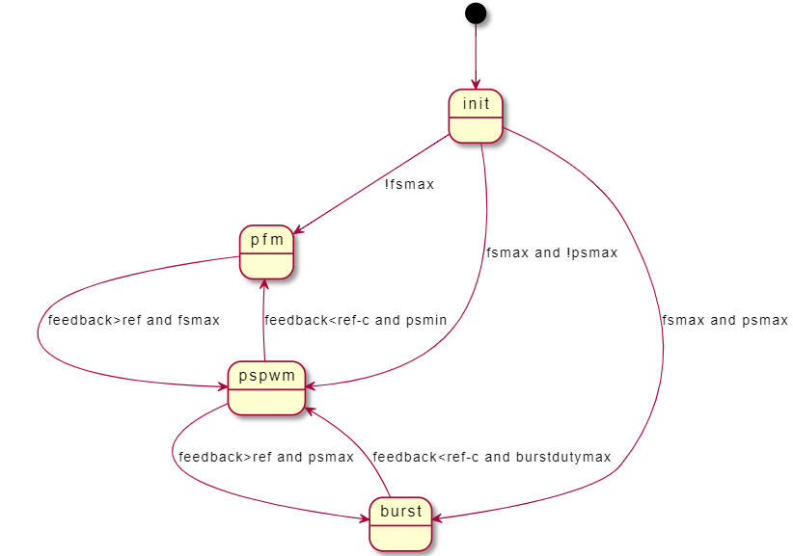
Regulation state machine
Control for full-bridge CLLC configuration

Slide 8
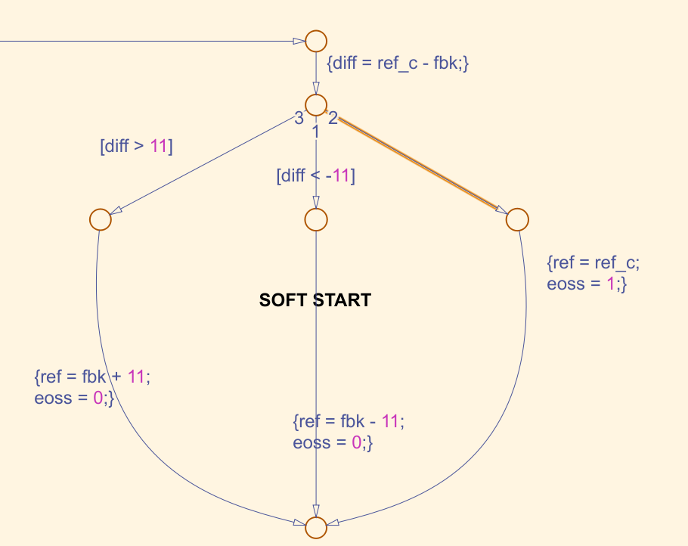
Softstart
Notes:
http://www.plantuml.com/plantuml/uml/SoWkIImgAStDuIfEJin9LJ0sDL0epqmfoU2ArefLqDMrKm0A9xiM5UKNAN1n0HMNf2A9L7Cf87WWnPbvoKMfkQbv9K6fQLOAgI1Xk-AIr09qTIcf6EfiTB4fJCqlBkQgXTgCOZp8SXG1LDSYDAMaece22X3K1BPNeHh8TqZDIm463m00

Slide 9
Code timing
Code timing diagram
PWM
ADCx
ADCINTx
C28x pipeline, PWM-synced
Parallel processing
thanks to CLA
Control law accelerator (CLA)
CLA, PWM-synced
Idle task
C28x pipeline

Slide 10
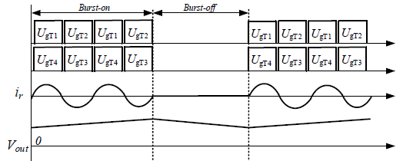
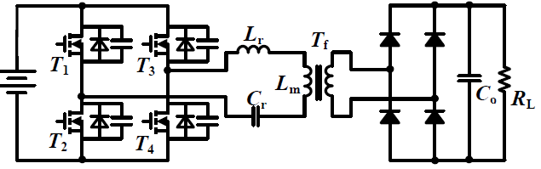
Reference study for burst mode control
Reference study:
“Burst Mode and Phase Shift Hybrid Control Method of LLC Converters for Wide Output Range Applications” by Shi et al.
LLC Topology
Key waveforms of burst mode control

Slide 11
Design
8-slot burst mode control
Lookup table
(burst duty% to
8-slot)
ON/OFF
Control
burst duty%
num. of ON pulses

Slide 12
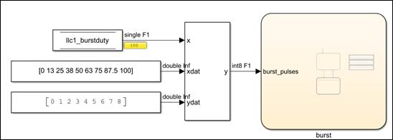
Burst mode control implementation
Burst frequency: Switching frequency/8
Burst duty: variable
Figure 1. Implemented in ADCINT loop

Slide 13
Synchronous rectifier control
In Bidirectional topology, for SR we require to use MOSFET instead of diodes and therefore we must be careful in switching of the SR switches in sync in the main drive.
The response time for any changes in main drive side should be fast and needs to react very quickly on the SR side as well.
In order to achieve that we need a independent fast processing logic and hence CLB is used.
With the Configurable Logic Block (CLB) peripheral you can implement custom logic and even augment existing peripherals like the PWMs. Thus, we don’t need separate FPGA to achieve this, and can be done is the same TI MCU.
cmph
cmpl
md RE
CLB
Stage 1: Digital filter for SR ON
Stage 2: Utilize 2 comparators for custom hysteresis
Stage 3: Limit one SR pulse per one cycle of main drive PWM
pwmout
cmph – comparator that determines SR turn ON level
cmpl – comparator that determines SR turn OFF level
md RE – gives the rising edge timing of the main drive PWM
pwmout – SR pulse

Slide 14
Synchronous rectifier control – MCU interface
MCU
Sensing circuit
Is
Isense
Configurable logic block (CLB)
CMPH
PWMA
DACH
Insert main drive PWM zero
DACL
CMPL
PWMB

Slide 15
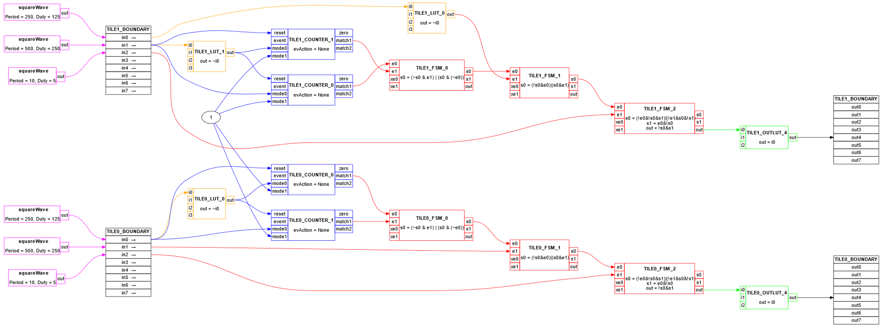
Design
SR Control for CLLC DC-DC Converter using CLB Tiles in CCS

Slide 16
Thank you

